Slide 1
Lecture 2
Note: Some slides and/or pictures are adapted from Lecture slides / Books of
Dr Zafar Alvi.
Text Book - Aritificial Intelligence Illuminated by Ben Coppin, Narosa Publishers.
Ref Books
Artificial Intelligence- Structures & Strategies for Complex Problem Solving by George F. Luger, 4th edition, Pearson Education.
Artificial Intelligence A Modern Approach by Stuart Russell & Peter Norvig.
Artificial Intelligence, Third Edition by Patrick Henry Winston

Slide 2
Outline
Knowledge Representation
Problem solving
Problem solving steps

Slide 3
Knowledge Representation
The representation that is used to represent a problem is very important.
The way in which the computer represents a problem, the variables it uses, and the operators it applies to those variables can make the difference between an efficient algorithm and an algorithm that doesn’t work at all.

Slide 4
Knowledge Representation
There are many ways to represent knowledge
Semantic Nets
Inheritance
Frames

Slide 5
Semantic Nets
A semantic net is a graph consisting of nodes that are connected by edges.
The nodes represent objects, and the links between nodes represent relationships between those objects.
The links are usually labeled to indicate the nature of the relationship.

Slide 6
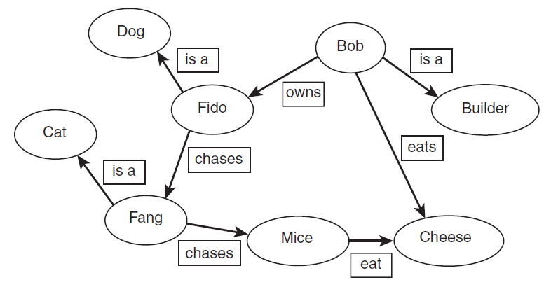
Semantic Nets

Slide 7
Semantic Trees
A semantic tree is a kind of semantic net that has the following properties:
Each node (except for the root node) has exactly one predecessor (parent) and one or more successors (children).
When searching a semantic tree, we start at the root node.
Some nodes have no successors. These nodes are called leaf nodes. One or more leaf nodes are called goal nodes. These are the nodes that represent a state where the search has succeeded.
An ancestor of a node is a node further up the tree in some path. A descendent comes after a node in a path in the tree.

Slide 8
Semantic Trees
A path is a route through the semantic tree, which may consist of just one node (a path of length 0).A path of length 1 consists of a node, a branch that leads from that node, and the successor node to which that branch leads.
A path that leads from the root node to a goal node is called a complete path.
A path that leads from the root node to a leaf node that is not a goal node is called a partial path.

Slide 9
Semantic Trees
When comparing semantic nets and semantic trees visually, one of the most obvious differences is that semantic nets can contain cycles, but semantic trees cannot.
A cycle is a path through the net that visits the same node more than once.
In semantic trees, an edge that connects two nodes is called a branch.
If a node has n successors, that node is said to have a branching factor of n.
A tree is often said to have a branching factor of n if the average branching factor of all the nodes in the tree is n.
The root node of a tree is said to be at level 0, and the successors of the root node are at level 1. Successors of nodes at level n are at level n + 1.

Slide 10
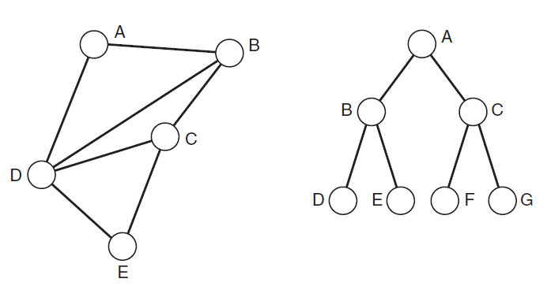
Semantic Net vs Semantic Tree

Slide 11
Search Tree
Searching a semantic net involves traversing the net systematically (or in some cases, not so systematically), examining nodes, looking for a goal node.
Clearly following a cyclic path through the net is pointless because following A,B,C,D,A will not lead to any solution that could not be reached just by starting from A.
We can represent the possible paths through a semantic net as a search tree, which is a type of semantic tree.

Slide 12
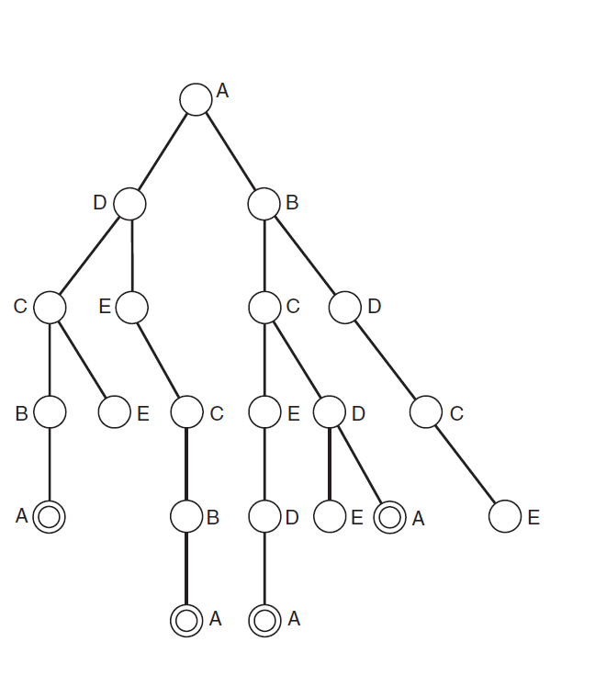

Slide 13
Problem Solving
Historically people viewed the phenomena of intelligence as strongly related to problem solving.
They used to think that the person who is able to solve more and more problems is more intelligent than others.

Slide 14
Ways of solving a problem
Hit and trail method (classical approach)
Mouse example
Consider that a child is to switch on the light in a dark room
Technical name given ( generate and test)
where we generate different combinations to solve our problem, and the one which solves the problem is taken as the correct solution.
The rest of the combinations that we try are considered as incorrect solutions and hence are destroyed.

Slide 15
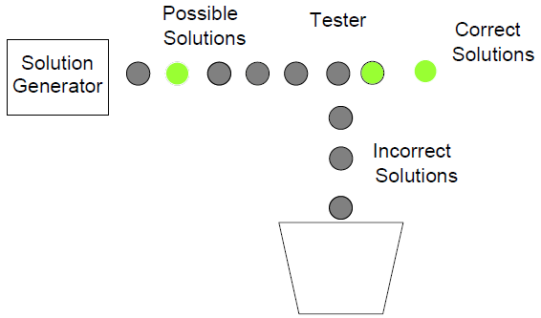
Generate and test

Slide 16
Problem Representation
The key to problem solving is actually good representation of a problem.
Natural representation of problems is usually done using graphics and diagrams to develop a clear picture of the problem in your mind.

Slide 17
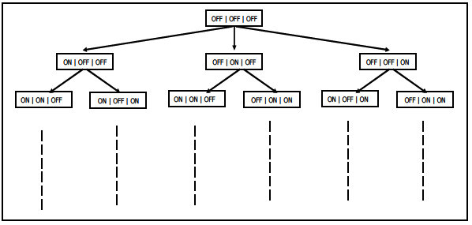
It shows the problem of switching on the light by a child in a graphical form.
Each rectangle represents the state of the switch board.
Goal can be found at different levels

Slide 18
Components of Problem Solving
Problem Statement (The two major things that we get to know about the problem is the Information about what is to be done and constraints to which our solution should comply)
Problem Solution (Ultimate aim or Goal State or the state that represents the solution of the problem)

Slide 19
Components of Problem Solving
Solution space (The set of the start state, the goal state and all the intermediate states)
Travelling in solution space (travel inside solution space in order to find a solution to our problem. The traveling inside a solution space requires something called “operators”. The action that takes us from one state to the other is referred to as an operator. In case of the mouse example, turn left, turn right, go straight are operators

